Slide 1
Planning for Accessible Meetings
By Nate Crippes and Sheri Newton

Slide 2
Sources
U.S. Access Board
Department of Justice
Mid Atlantic ADA Center
Web Accessibilty Initiative
Harvard University
Hospitality and Disability: An ADA National Network Initiative

Slide 3
American with Disabilities Act (ADA)
Physical Accessibility
Parking
Route
Entrance
Signage
Not covered: Restrooms, Passenger Drop-off areas, route from public transportation, etc.

Slide 4
Parking Spaces Scoping Requirements
(§208)

Slide 5
Location of Parking Space
On shortest accessible route to accessible entrance
Dispersed to multiple accessible entrances

Slide 6
Minimum Number of Accessible Spaces
Parking Facility Total | Standard | Van* | Total (Standard + Van)
1 - 25 | 0 | 1 | 1
26 – 50 | 1 | 1 | 2
51 – 75 | 2 | 1 | 3
76 – 100 | 3 | 1 | 4
101 – 150 | 4 | 1 | 5
151 - 200 | 5 | 1 | 6
201 – 300 | 5 | 2 | 7
301 – 400 | 6 | 2 | 8
401 – 500 | 7 | 2 | 9
501 – 1000 | [Total – van] | * | 2 percent of total
1001 – and over | [Total – van] | * | 20, plus 1 for each 100, or fraction thereof, over 1000
* at least 1 of every 6 accessible spaces or fraction of 6

Slide 7
Parking Scoping - Van Accessible Spaces
1 van space for every 6 accessible spaces required
There will always be at least one van space required

Slide 8
Parking Spaces Technical Requirements
(§502)

Slide 9
Surface and Slope
Required to be level
Both space itself and associated access aisle
Stable, firm, and slip resistant
Slope measured parallel to and perpendicular to the access aisle

Slide 10
Access Aisle - Location
Cannot overlap vehicle way
Can be shared by two vehicle spaces
Can be on either side of vehicle space
Access aisle must be on passenger side of van spaces where angled parking is provided
Recommendation: Provide access aisle for vans on the passenger side so that drivers do not have to back into the space

Slide 11
Access Aisle – Accessible Route
Accessible Route must connect to access aisles at accessible parking spaces
Recommendation: Connect accessible route to front of aisle to prevent travel behind parked cars

Slide 12
Access Aisle - Size
Width: 60″ minimum
Length: full length of served parking space
60″ min

Slide 13
Vehicle Space - Width
Measurement taken to center line of marked lines

Slide 14
Alternate Van Spaces and Access Aisle
Van parking spaces shall be permitted to be 96 inches wide minimum where the access aisle is 96 inches wide minimum.

Slide 15
Vertical Clearance for Vans
Vans requires at least 98″ of vertical clearance

Slide 16
Vertical Clearance Location
Minimum clearance applies to vehicular route from entrances to van spaces

Slide 17
Parking Space Signs
International Symbol of Access required to identify accessible spaces
Signs identifying van spaces must include the term "van accessible”
Exception: sign not required where 4 or fewer spaces are provided on a site

Slide 18
Parking Space Signs - Height
60 inches minimum to bottom of sign
Including “Van accessible” signs

Slide 19
Parking Space Signs – Height Example

Slide 20
Parallel Parking
All parking requirements still apply

Slide 21
Temporary Parking Solutions

Slide 22
Route of Travel Technical Requirements
(§502)

Slide 23
Route of Travel: inside and outside

Slide 24
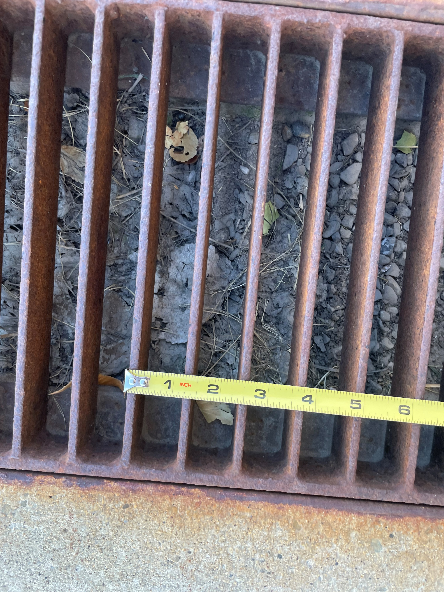
Route considerations
Is the walking surface stable firm and slip resistant?
Is the route free of surface openings greater than ½”
Is the route free of changes in level greater than ½”?

Slide 25
Route considerations
Is the route at least 36” wide?
Is the running slope less than 5%? (slopes greater than 5% are subject to ramp requirements)
Is the cross slope no greater than 2.08%

Slide 26
Route considerations – protruding objects
Is the route free of items at the height of 27”-80” that protrude from the wall?
display cases
water fountains
signs
ceiling mounted televisions
drop boxes

Slide 27
Route Solutions?
Place object (box, cone, trash can) beneath protruding object

Slide 28
Entrance

Slide 29
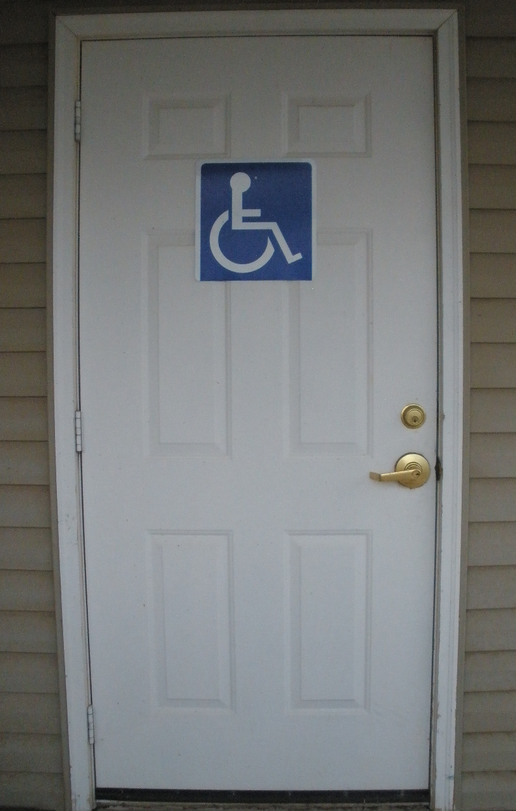
Entrance
Is there one accessible entrance connected with an accessible route?
Is the doorway at least 32”

Slide 30
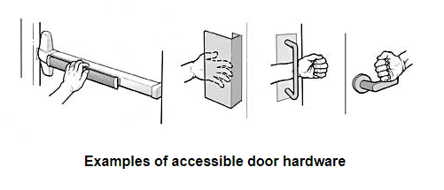
Entrance
Can the door be opened with a flat palm or closed fist?
Is the threshold height less than ½ inch or ¾ inch beveled?

Slide 31
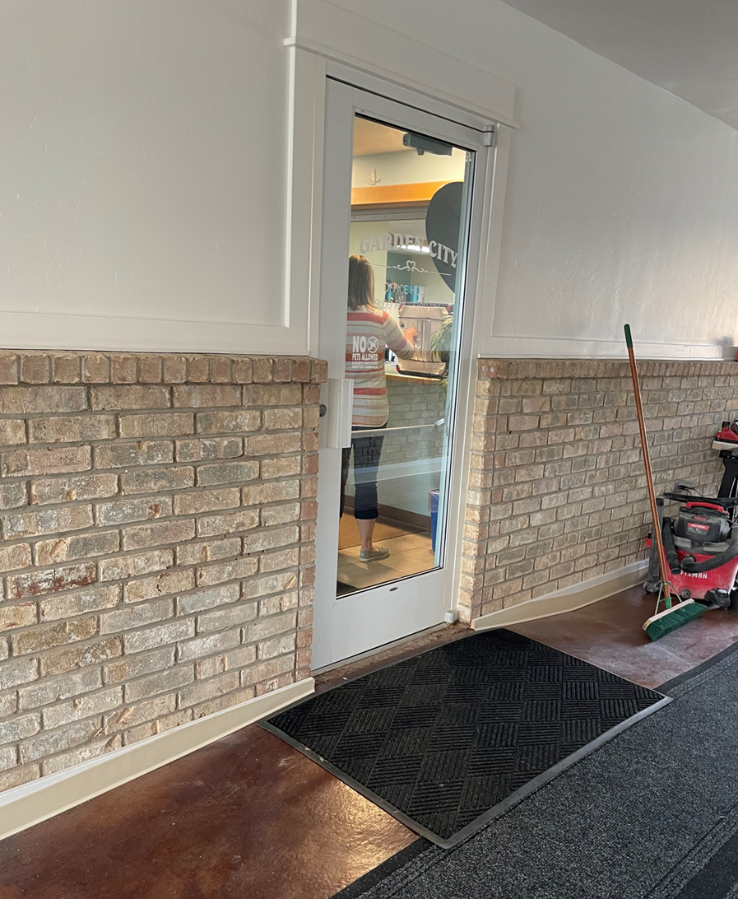
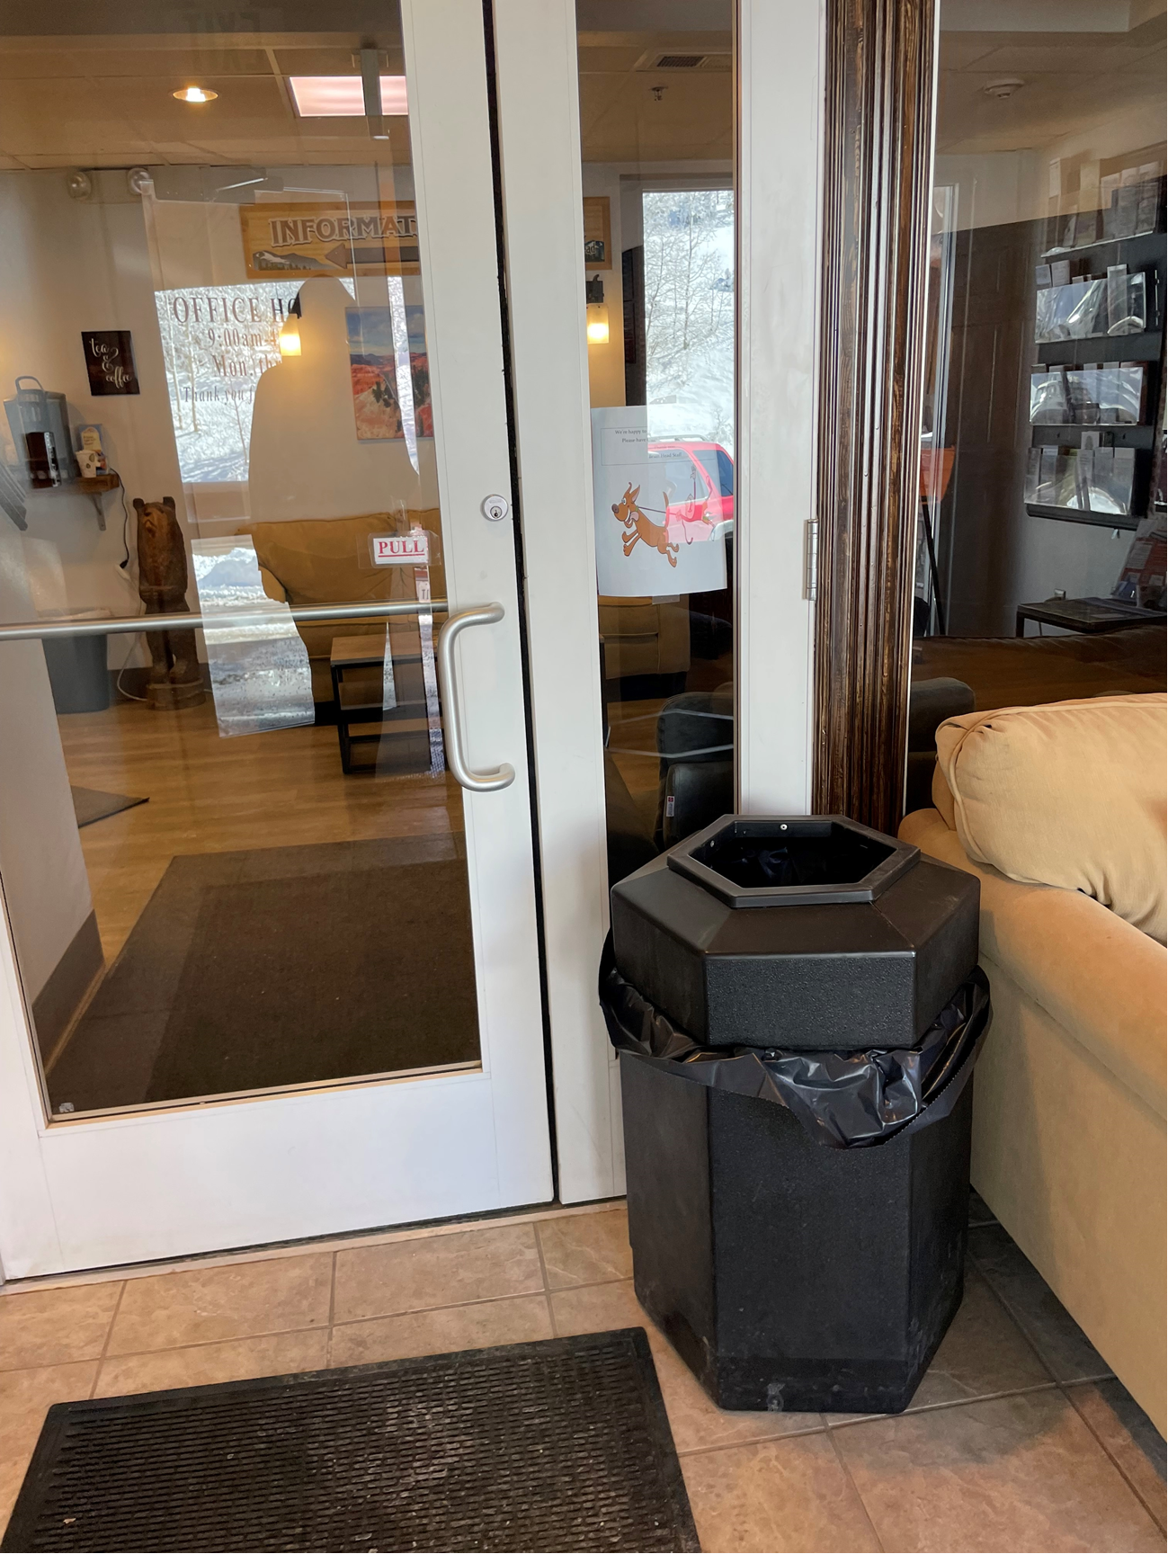
Entrance
Is there a 60-inch level area in front of the door?
Is there 18 inches of clear space on the pull side of the door?

Slide 32
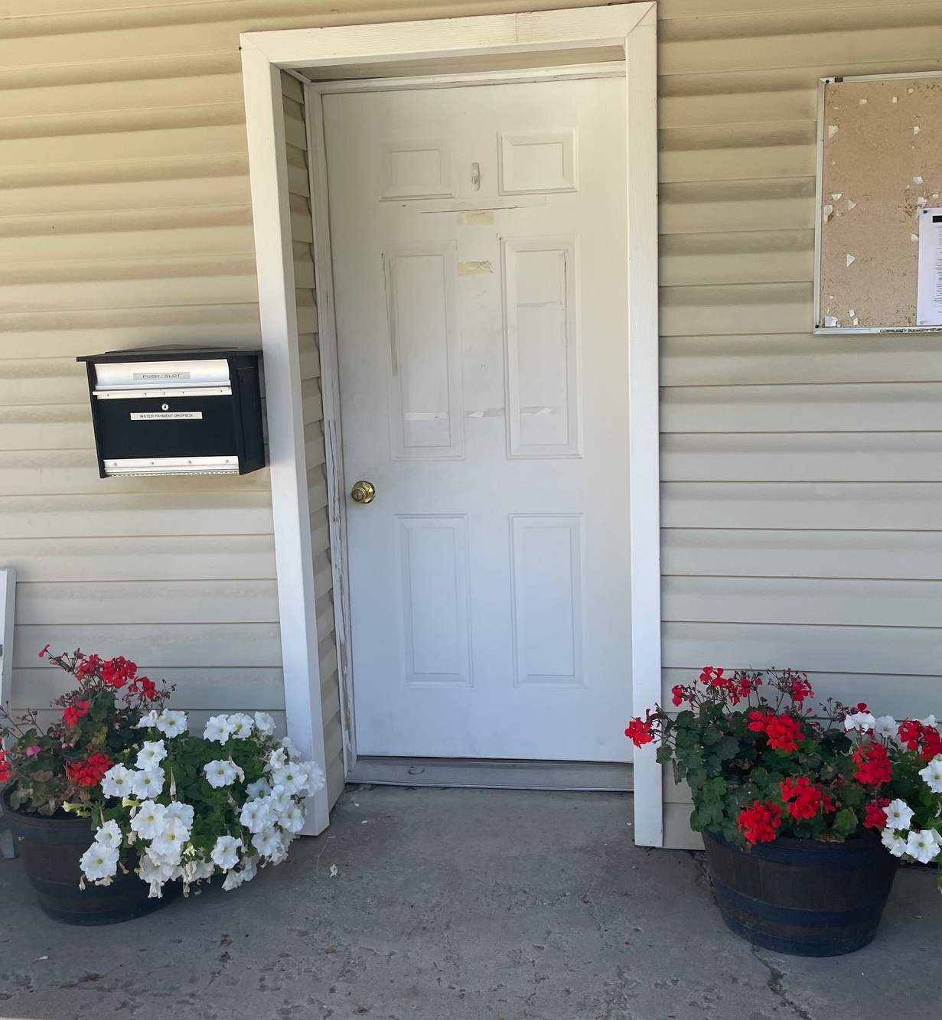
Entrance Solutions? Prop the door open.

Slide 33
Signage

Slide 34
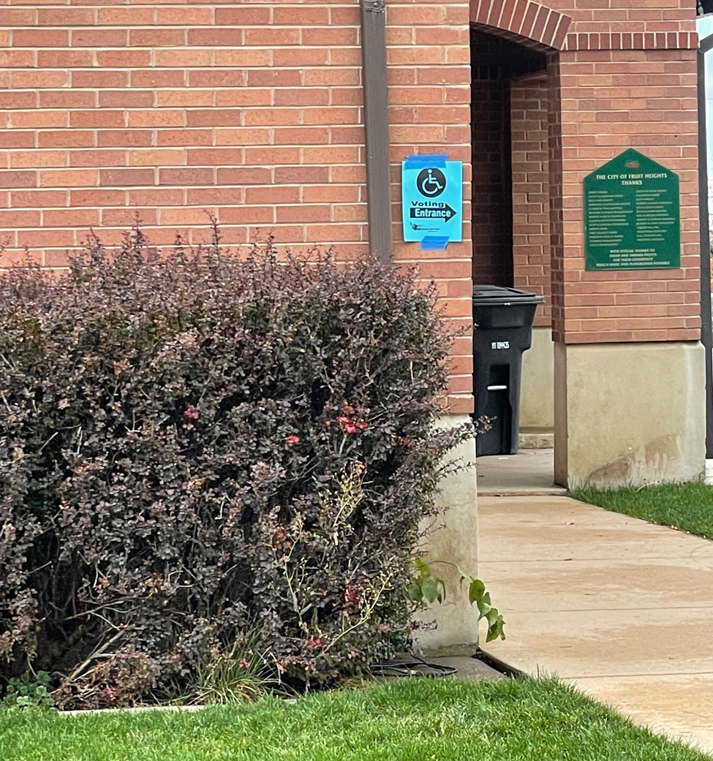
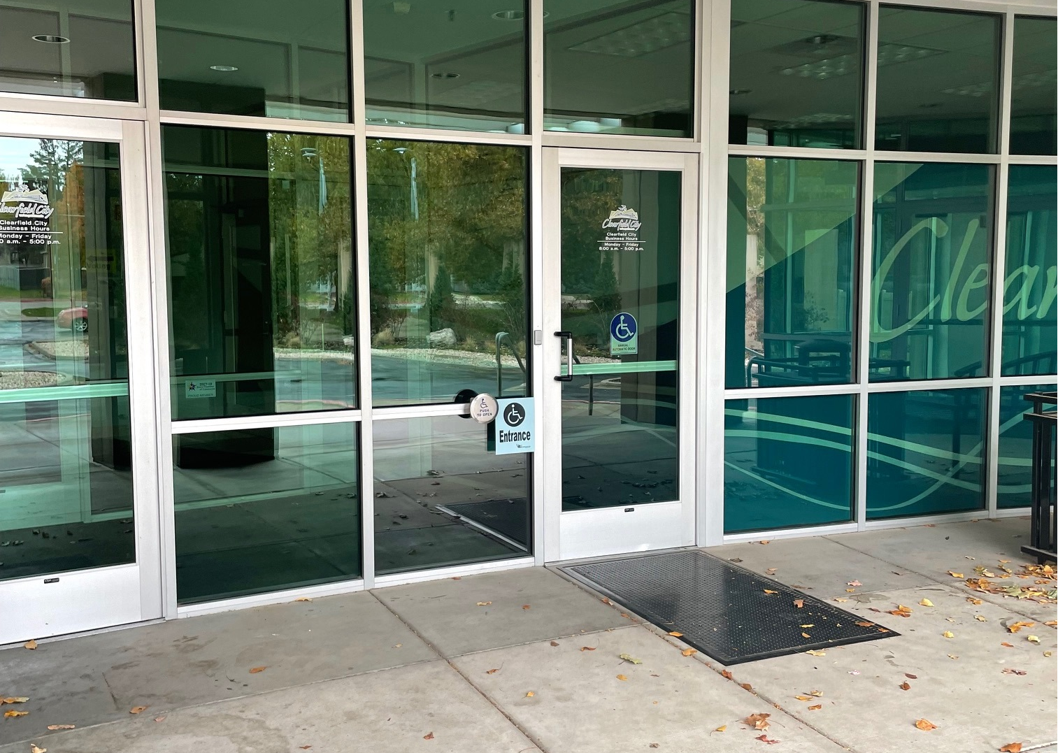
Accessible Entrance
Directions to the entrance
Marking the accessible entrance

Slide 35
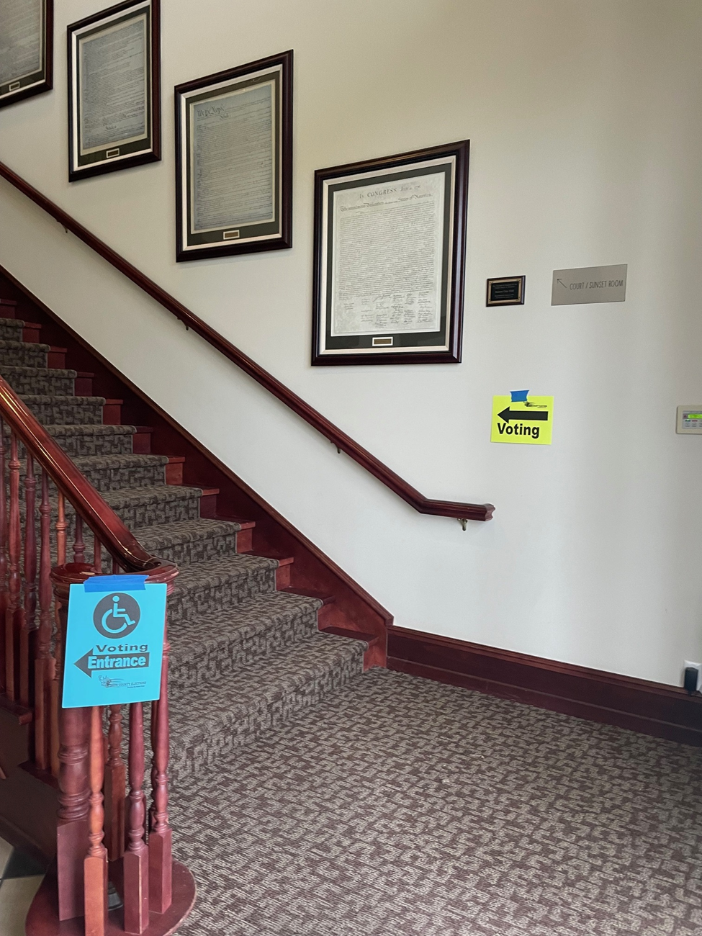
Accessible Entrance
Directions to accessible pathway

Slide 36
Your Input
What accessibility features are important to your meeting participants?
What have you done to make past meetings more accessible?

Slide 37
In-Person Meeting Set-Up
Circulation space should be 36 inches and preferably 60 inches. 72” passing space is recommended.
Include both horizontal (side to side) and vertical (front to back aisles to improve access and flow.
Area to park scooters and mobility devices
Accessible locations to sit throughout the room
A spacious area in the back or sides of the room for those who need to stand
Plenty of space between group discussions.

Slide 38
MEETING SET-UP

Slide 39
Meeting Set-Up
Was there a greeter offering assistance at the main entrance or meeting room entrance?
Was it clear who to reach out to for help?
Check-in table: room to navigate? appropriate height?
Aisles 60 inches wide
Spaces for wheelchair seating?

Slide 40
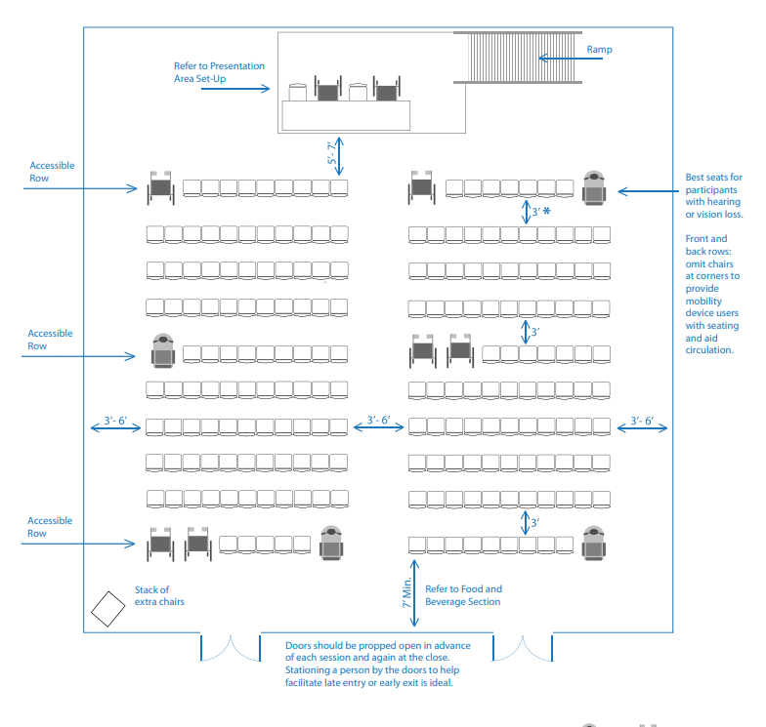
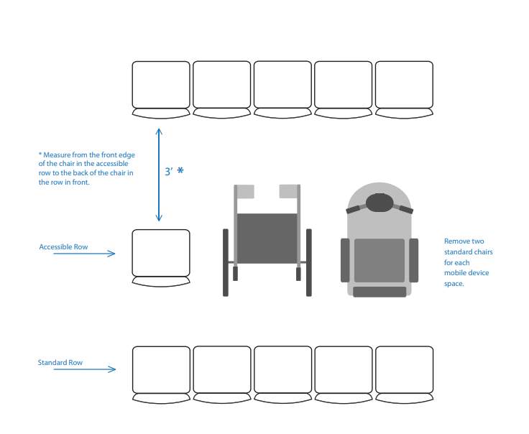
Layout Examples – Theater Style

Slide 41
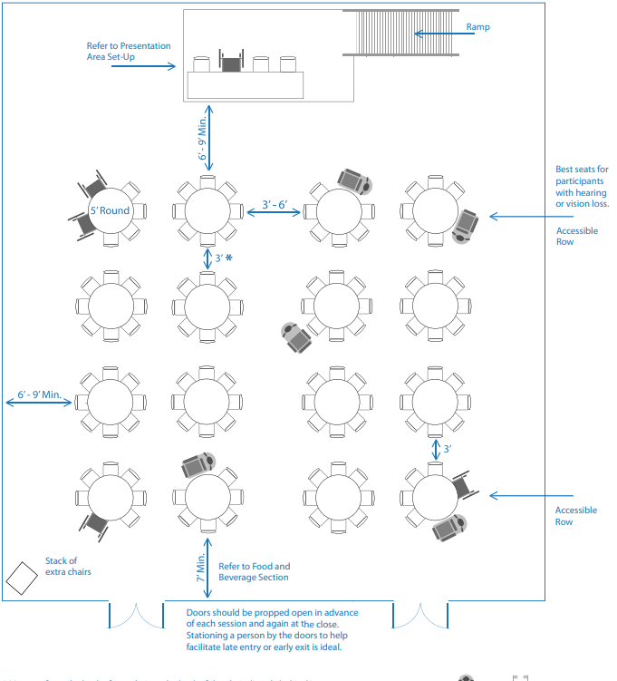
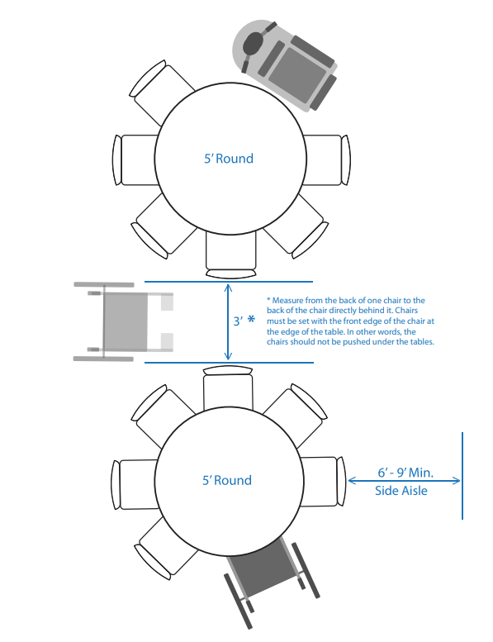
Layout Examples – Round Table Style

Slide 42
During the Meeting
Did speakers use a microphone?
If a video was shown, did it have captions?
If visuals were used, did the speaker describe the visuals?
Did you notice other accommodations: sign language interpreters, large print materials, magnifying sheets or large grip pens?
If multiple groups were meeting in one area, was there an option to move to a different location if the ambient noise was difficult for a participant?

Slide 43
Voting
How did participants vote?
If paper ballots were used, was there an alternative method available for someone who cannot read or mark a paper ballot?

Slide 44
Other Meeting Features
ACCOMMODATIONS

Slide 45
In-Person Meeting Set-Up
Designated person to coordinate accommodation needs
Greeters at the door to assist and lead participants to the right area
Use amplification
Videos should be captioned
Plan for alternative ways voters with physical limitations can participate and vote

Slide 46
More Meeting Tips and Info
Hospitality & Disability
https://www.adainfo.org/hospitality/accessible-meetings-events-conferences-guide/#tab6
Harvard University
https://accessibility.harvard.edu/event-planning

Slide 47
VIRTUAL MEETINGS

Slide 48
VIRTUAL MEETING CONSIDERATIONS
Choosing a Platform
Managing Registration
Arranging for Accommodations
Ensuring Accessiblity
Tips for Presenters and Participants

Slide 49
Choosing a Platform
Is the software accessible for those who use screen-reading software?
Can third-party captioning be integrated?
Not everyone has access to a computer or reliable internet connection. Does the platform support call in via telephone?
Provide support or in advance instructions for those who need help operating the platform.
Can you pin a screen for the sign language interpreter?

Slide 50
Registration or Pre-Meeting Communications
Designate an accessibility point person and make his/her phone number and email address available on all event materials
Materials should include specific information about accessibility features available during the event and how to request additional accommodations.

Slide 51
Sample Language
“Live captioning and American Sign Language interpretation will be available during this event. Should you require any other accommodation or service to fully participate, please contact [NAME at EMAIL, PHONE NUMBER] at least [#] days prior to the event. Participants can log in to the event platform 30 minutes prior to the start of the event for troubleshooting and technology support.”

Slide 52
Arranging for Accommodations
Event attendees may require a variety of accommodations to participate. It’s important to factor these into your budget. Examples include:
Communication access real-time translation (CART), also called live or real-time captioning
Sign language interpretation
Accessible digital materials
Large print
Provision of event materials in advance to allow for extra time to process information

Slide 53
Planning for Accessibility
Examples:
Caption and audio-describe any pre-recorded media that will be shared during the event
Avoid media that include bright, flashing lights
Develop accessible presentation materials (such as PowerPoint slide presentations and Word documents) with easy-to-read fonts, contrasting colors, and image descriptions or alternative text
Prior to the event, host a live run-through for presenters, captioners, and interpreters. This can help prevent technical issues and help ensure everyone is on the same page regarding the flow of the event.

Slide 54
Tips for Presenters and Participants
Use best practices for slides and visuals.
Describe all relevant visual information
Limit chat when a participant is using a screen reader
Speak clearly
Use simple language (avoid acronyms and idioms)
Pause between topics. Give plenty of time for people to process the information and formulate their questions
Be visible, good lighting. Some folks benefit from lip reading.
Repeat items in the chat.
Limit distractions (notifications, side conversations)

Slide 55
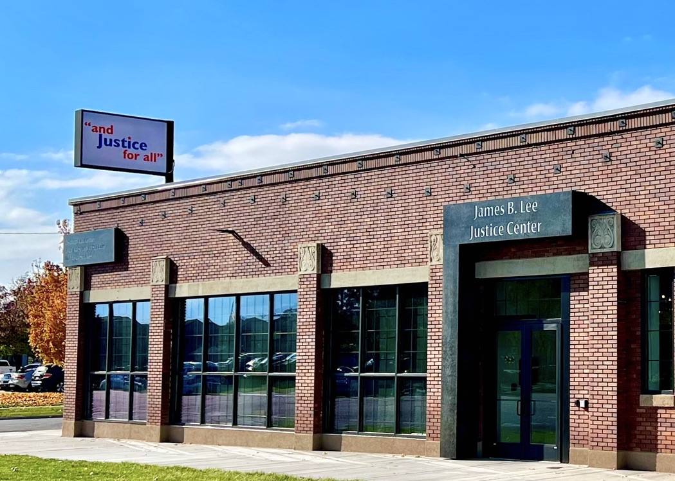
Sheri Newton snewton@disabilitylawcenter.org (800) 662-9080

